Slide 1
William Shakespeare
Spotlight 9 Module 5
Culture Corner
Работа выполнена учителем английского языка МОБУ Никитинская СОШ Саракташского района оренбургской области
Тукманбетовой л.р.

Slide 2


Slide 3
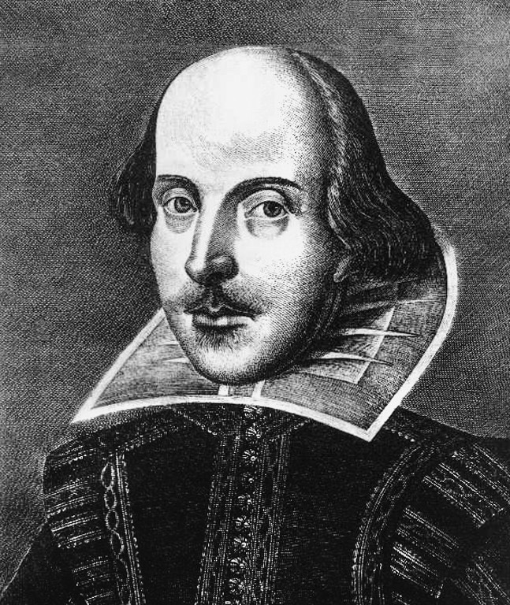
William Shakespeare was born in Stratford-upon-Avon in England in April 23rd in 1564 into a family of a prosperous wool-dealer.

Slide 4

In 1582 he married Anne Hathaway who bore him 3 children. Virtually nothing is known of Shakespeare’s life from 1585-1592. Tradition has it that he left Stratford with a company of actors. Certainly he found his way to London, where he became connected with “Globe” theatre as an actor and playwright.

Slide 5
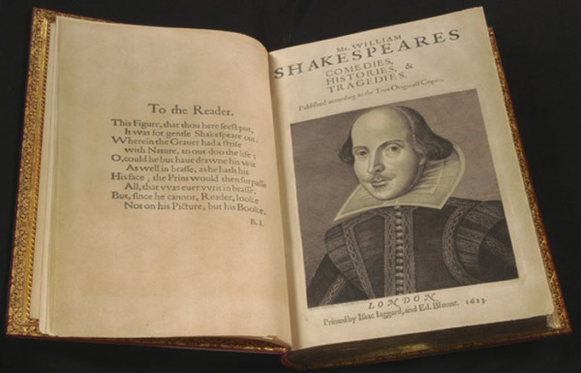
His earliest plays, written in 1589-93, include “The Comedy of Error’s, “The Taming of the Shrew”, “Two Gentlemen of Verona”.

Slide 6



Before 1601 Shakespeare wrote

Slide 7
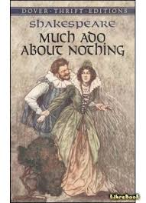

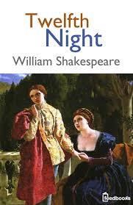
His comedies also include

Slide 8

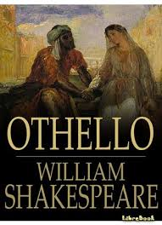

From 1601 Shakespeare wrote his best tragedies

Slide 9
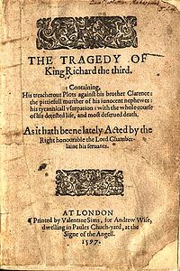

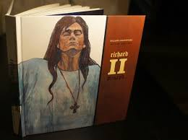

His historical plays include

Slide 10

Shakespeare is also known as the author of 2 poems and 154 sonnets.

Slide 11

Unknown Shakespeare
The longest play is “Hamlet” with 4042 lines and 29551 words, 1242 words longer than “Richard III.
Shakespeare had one of the largest vocabularies of any English writer, about 30000 words.
He had an extraordinary grasp of medical service. In 37 plays he mentioned practically all the diseases and drugs of the day.

Slide 12
Check yourself
Shakespeare’s plays are only performed and studied in England.
False
Shakespeare earned a lot of money.
Not stated
“Romeo and Juliet” is a comedy.
False
There weren’t any women actors in his plays.
True
Shakespeare’s plays showed what life was like in Elizabethan times.
True
The original Globe Theatre was destroyed by fire.
True

Slide 13
Much ado about nothing
The beginning of the end
To win golden opinions
Life is not all cakes and ale
Sweets to sweet
Brevity is the soul of wit
Жизнь прожить – не поле перейти
Прекрасное – прекрасной
Много шума из нечего
Начало конца
Краткость сестра таланта
Заслужить благоприятное мнение

Slide 14
Thank you for
attention!

Slide 15
https://www.google.ru/search?q=%D1%88%D0%B5%D0%BA%D1%81%D0%BF%D0%B8%D1%80+%D0%B8+%D0%BF%D1%80%D0%BE%D0%B8%D0%B7%D0%B2%D0%B5%D0%B4%D0%B5%D0%BD%D0%B8%D1%8F&newwindow=1&espv=2&biw=1366&bih=662&source=lnms&tbm=isch&sa=X&ved=0ahUKEwimkaqb1d_RAhWF1iwKHXQjDQkQ_AUIBigB

